Slide 1
Packaging Requirements:
Watts has a NEW standard for Barcode Labels of standard packages to us with QR codes.
Please review our new standard and please update your box labels.
Please make sure the part number is on ALL boxes. (The “Lead Free” items look the same just as a different base alloy).
Please keep the total weight of boxes below 40 pounds per box.
Please note the packaging specifications on our website (LINK).
New Box Label Standard for Watts.

Slide 2
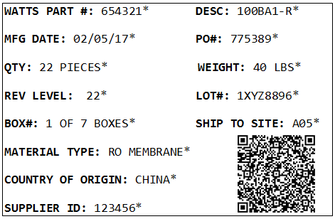
Standard Box Label
As of 1/1/2018 Watts will require suppliers to label all boxes shipped to Watts facilities in a fashion similar to the one displayed on the right
Order of information must be the same from top to bottom; Alignment can vary as long as order is maintained
Terminology must match exactly
Please include units where appropriate (i.e. LBS, BOXES, PIECES)
One QR code per Part
An asterisk (*) is required after each piece of information in order for our scanners to read the code. (See above)
Min. Bar Code size of 3/8 inch by 3/8 inch.

Slide 3
The QR Code
QR codes function similarly to barcodes but can hold more information
Several free websites offering QR code generation
No software required with free websites; but both paid and free software available if generating offline is desired
Information must be typed into QR code generation in the same order as it is on the right, top to bottom
All info on the label is embedded in the QR Code

Slide 4
Methods of QR Code Generation
Example generators
Watts Requirements:
Websites (Always select to enter as plain text where available)
www.the-qrcode-generator.com
www.qrstuff.com
www.qr-code-generator.com
www.qrcode-monkey.com/
http://www.online-barcode-generator.net/
Downloadable Software
Media Freeware
Viscom Software
Fields to include in order
Part #
Manufacture Date
Quantity
Revision
Box #
Material Type
Country of Origin
Supplier ID
Description
Purchase Order
Weight
Lot Number
Ship to Site
*Please note that the above software and websites are displayed as an example of the multitude of QR generation capabilities available. Watts cannot endorse or verify the reliability, security, or capability of any of the above websites or software.*

Slide 5
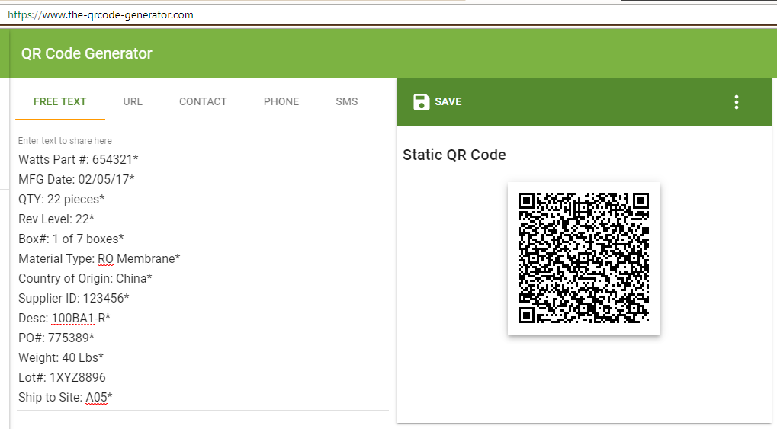
Example Online User Interface

